Slide 1
RE-MATCH! Presents…
“Pacific Theater”

Slide 2
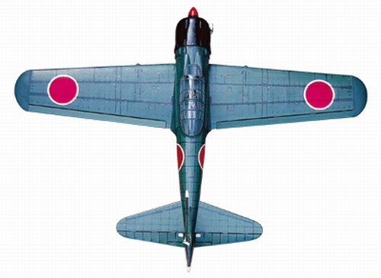
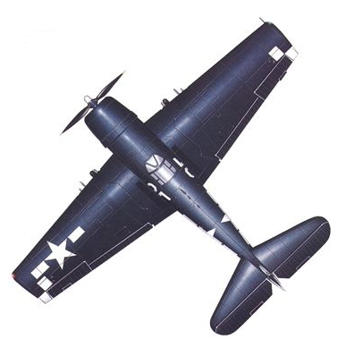
Japanese Kamikaze And Grumman F6F Hellcat Planes

Slide 3

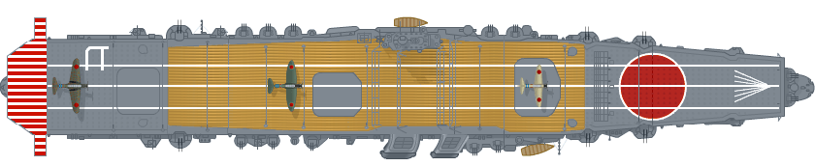
USS Yorktown and IJN Hiryu

Slide 4

Enemy planes left: 5
Planes shot down: 1
USS Yorktown health: 100
Stage 1 of the game!
(Defending against kamikaze planes)

Slide 5
IJN Hiryu health: 20
Your fuel remaining: 100
Your health: 100
Enemy kamikaze planes remaining: 2
Stage 2 of the game!
(Attacking the enemy carrier)

